Slide 1

The Making of
Slides

Slide 2
Objective
Drawing labelled diagrams of objects observed under the microscope.

Slide 3
Wet Mounted Slide
1 – Get a clean slide and cover-slip from your teacher.
2 – Place ONE drop of water in the middle of the slide. Don’t use too much or the water will run off the edge and make a mess!
3 – Place the edge of the cover slip on one side of the water drop.
4 - Slowly lower the cover slip on top of the drop.
Cover Slip
Lower slowly
5 – Place the slide on the stage and view it first with the red-banded objective. Once you see the image, you can rotate the nosepiece to view the slide with the different objectives.

Slide 4
Drawing of
Slides

Slide 5
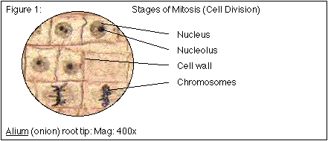
Drawing a Slide
1. Use pencil - you can erase and shade areas.
2. All drawings should include clear and proper labels (and be large enough to view details). Drawings should be labeled with the specimen name and magnification.
3. Labels should be
written on the
outside of the
circle.

Slide 6
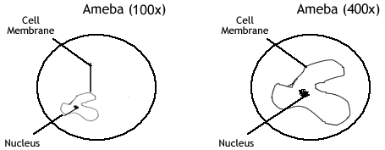
Drawing a Slide
4. The circle indicates the viewing field as seen through the eyepiece. Specimens should be drawn to scale ie. if your specimen takes up the whole viewing field, make sure your drawing reflects that. If it only takes up a ratio of the view, then you need to show that.

Slide 7
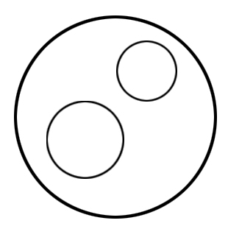
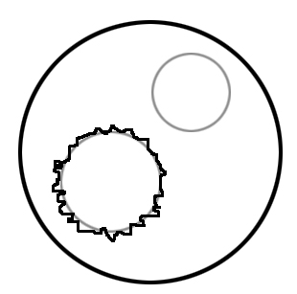
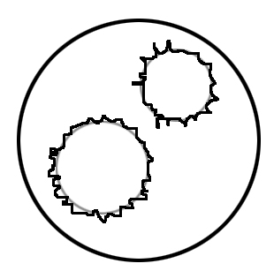
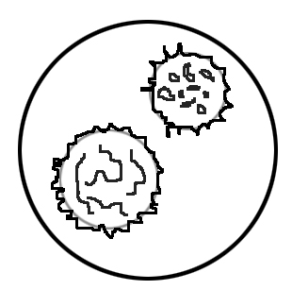
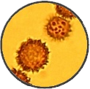
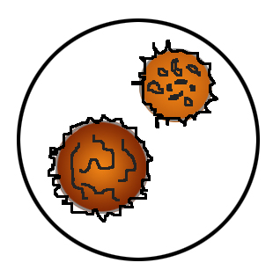
Let’s give it a try ...
Choose to draw the two central Mushroom Spores, as the other two are not complete.
Draw the outline of each in similar detail to the slides field of view.
Draw two light circles that are in scale with the slides field of view.
Add detail and shading and colour.

Slide 8
Let’s give it a try ...
Choose to draw the two central Mushroom Spores, as the other two are not complete.
Add title, labels, and scale.

Slide 9
Let’s give it a try ...
Mushroom Spores (Scleroderma Areolatum) at 3000X total magnification
Spiny Spores

Slide 10
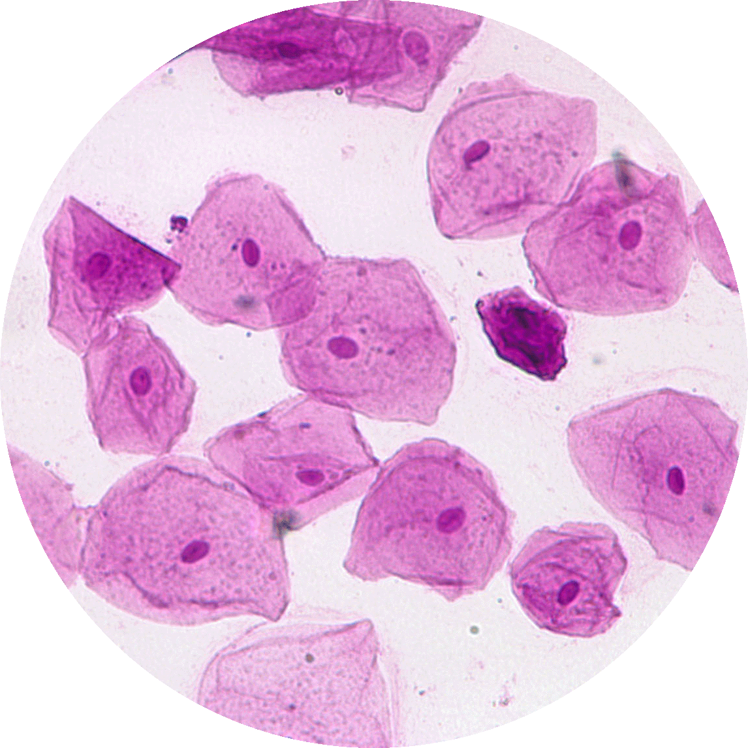
Let’s give it a try ...
Low Power
Ocular Lens 15X
Objective Lens 50X
Cheek Skin Cells
Should have labelled the
Nucleus
Cytoplasm
Plasma (Cell) Membrane

Slide 11
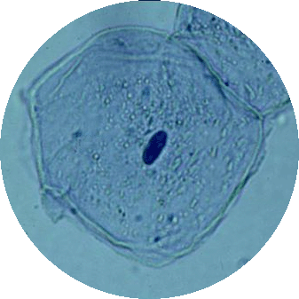
Let’s give it a try ...
High Power
Ocular Lens 15X
Objective Lens 300X
Cheek Skin Cells
Should have labelled the
Nucleus
Cytoplasm
Plasma (Cell) Membrane
Microtubule

Slide 12
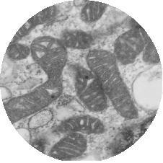
Let’s give it a try ...
Low Power
Ocular Lens 1X
Objective Lens 5000X
Mitochondrion within a Plant Cells
Should have labelled the
Inner Membrane
Outer Membrane

Slide 13
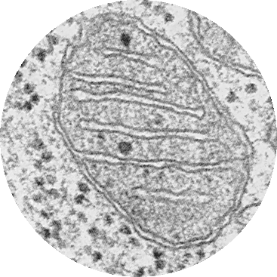
Let’s give it a try ...
High Power
Ocular Lens 1X
Objective Lens 40000X
Mitochondrion within a Plant Cells
Should have labelled the
Inner Membrane
Outer Membrane
Ribosome

Slide 14
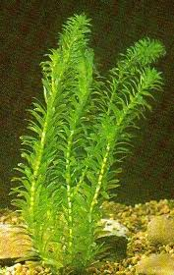
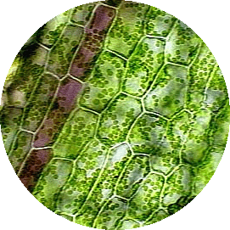
Let’s give it a try ...
Low Power
Ocular Lens 10X
Objective Lens 80X
Elodea (aquatic plant)
Should have labelled the
Cell Wall
Chloroplasts
Cytoplasm
1 mm

Slide 15
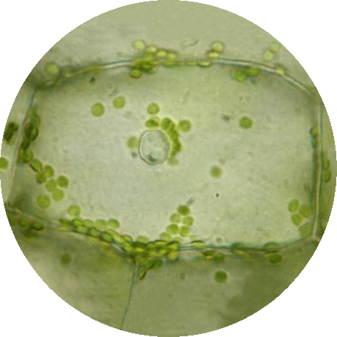
Let’s give it a try ...
High Power
Ocular Lens 10X
Objective Lens 700X
Elodea (aquatic plant)
Should have labelled the
Nucleus
Cell Wall
Chloroplasts
Cytoplasm

Slide 16

Let’s give it a try ...
Low Power Magnification
Low Mag = 10 x 80 = 800X
Diameter of Low power Field of View
Low FofV = 1.4 mm
Low FofV = 1.4 x 1000 = 1400 µm
High Power Magnification
High Mag = 10 x 700 = 7000X
Diameter of High power Field of View
Field of view for 7000X magnification
800 = ? .
7000 1400
? = 160 µm
1 mm
Low Power
Ocular Lens 10X
Objective Lens 80X
High Power
Ocular Lens 10X
Objective Lens 700X

